Slide 1
Quantum Computing
A brief introduction
John Manferdelli
JohnManferdelli@hotmail.com
© 2021-2025, John L. Manferdelli.
This material is provided without warranty of any kind including, without limitation, warranty of non-infringement or suitability for any purpose. This material is not guaranteed to be error free and is intended for instructional use only.

Slide 2
Beam splitters and QM I can safely say that no one understands Quantum Mechanics - Feynman
Experiment 1
Detector 1
Detector 2
Photon source
Half silvered mirror
Photon source emits stream of photons.
P(photon arrives at Detector 1)= .5
P(photon arrives at Detector 2)= .5
So far, so good

Slide 3
Beam splitters and QM Mach-Zender Interferometer
Experiment 2
Detector 1
Half silvered mirror
0
Mirror
Detector 2
1
1
1
0
0
Mirror
Photon source
Half silvered mirror
Photon source emits stream of photons.
P(photon arrives at Detector 1)= 0
P(photon arrives at Detector 2)= 1
Huh?

Slide 4
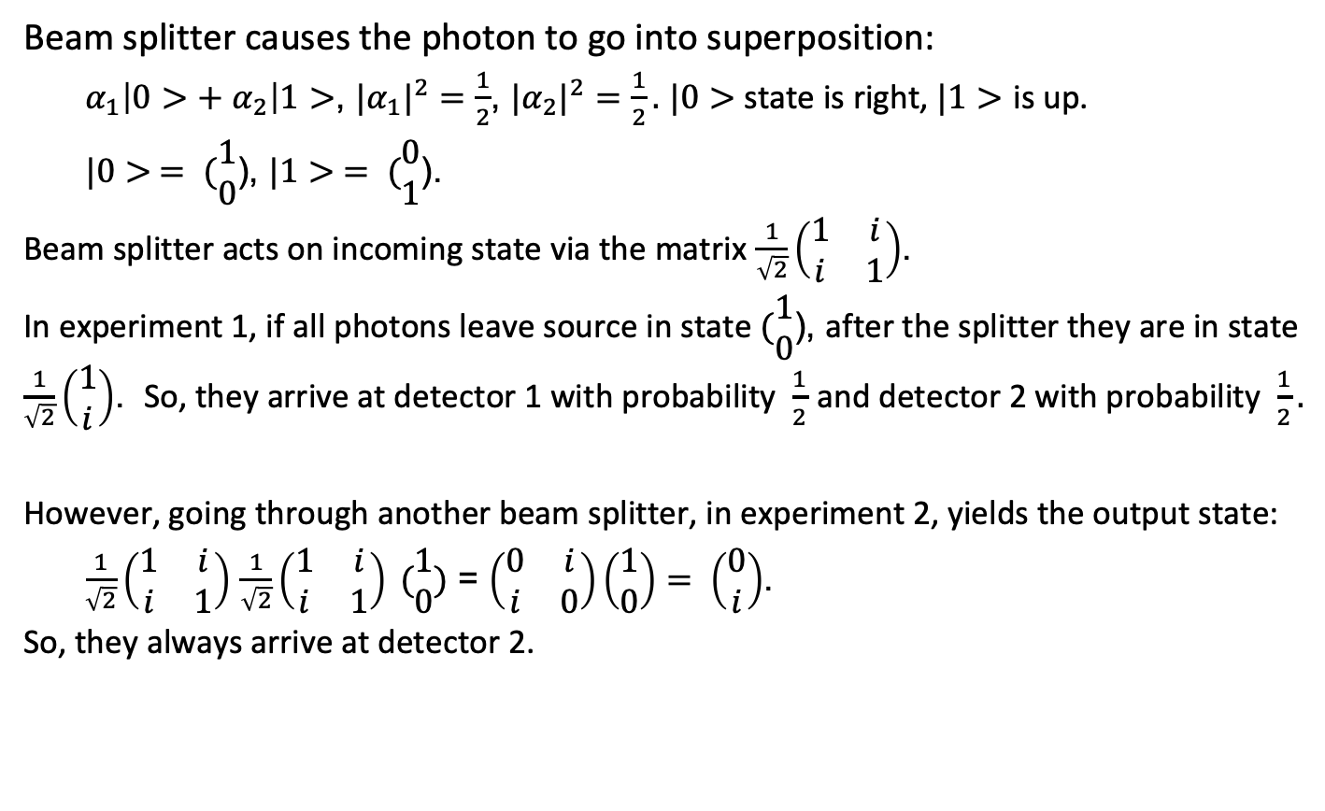
According to QM Analysis
Beam splitter causes the photon to go into superposition:
$α_{1}\left|0>+ α_{2}\right|1>$, ${|α_{1}|}^{2}=\frac{1}{2}$, ${|α_{2}|}^{2}=\frac{1}{2}.$ $|0>$state is right, $|1>$ is up.
$|0> = (\begin{matrix}1 \\ 0\end{matrix}$), $|1> = (\begin{matrix}0 \\ 1\end{matrix}$).
Beam splitter acts on incoming state via the matrix $\frac{1}{\sqrt{2}}\left(\begin{matrix}1 & i \\ i & 1\end{matrix}\right)$.
In experiment 1, if all photons leave source in state $(\begin{matrix}1 \\ 0\end{matrix}$), after the splitter they are in state $\frac{1}{\sqrt{2}}\left(\begin{matrix}1 \\ i\end{matrix}\right)$. So, they arrive at detector 1 with probability $\frac{1}{2}$ and detector 2 with probability $\frac{1}{2}.$
However, going through another beam splitter, in experiment 2, yields the output state:
$\frac{1}{\sqrt{2}}\left(\begin{matrix}1 & i \\ i & 1\end{matrix}\right)$ $\frac{1}{\sqrt{2}}\left(\begin{matrix}1 & i \\ i & 1\end{matrix}\right) (\begin{matrix}1 \\ 0\end{matrix})$ = $\left(\begin{matrix}0 & i \\ i & 0\end{matrix}\right)\left(\begin{matrix}1 \\ 0\end{matrix}\right)= \left(\begin{matrix}0 \\ i\end{matrix}\right)$.
So, they always arrive at detector 2.

Slide 5
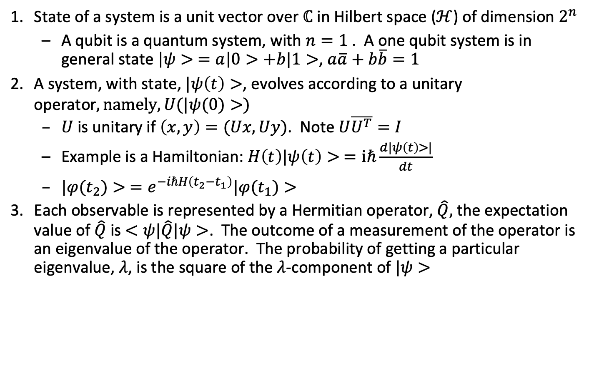
Postulates
State of a system is a unit vector over $ℂ$ in Hilbert space ($ℋ$) of dimension $2^{n}$
A qubit is a quantum system, with $n=1$ . A one qubit system is in general state $\left|ψ> =a\right|0>+b|1>$, $a\overline{a}+b\overline{b}=1$
A system, with state, $|ψ\left(t\right)>$, evolves according to a unitary operator$, namely, U(|ψ(0)>)$
$U$ is unitary if $\left(x,y\right)=(Ux, Uy)$. Note $U\overline{U^{T}}=I$
Example is a Hamiltonian: $H\left(t\right)|ψ\left(t\right)> =iℏ\frac{d|ψ\left(t\right)>|}{dt}$
$|φ(t_{2})> =e^{−iℏH\left(t_{2}−t_{1}\right)}|φ(t_{1})>$
Each observable is represented by a Hermitian operator, $\hat{Q},$ the expectation value of $\hat{Q}$ is $<ψ|\hat{Q}|ψ>$. The outcome of a measurement of the operator is an eigenvalue of the operator. The probability of getting a particular eigenvalue, $λ$, is the square of the $λ$-component of $|ψ>$
$$|$$

Slide 6
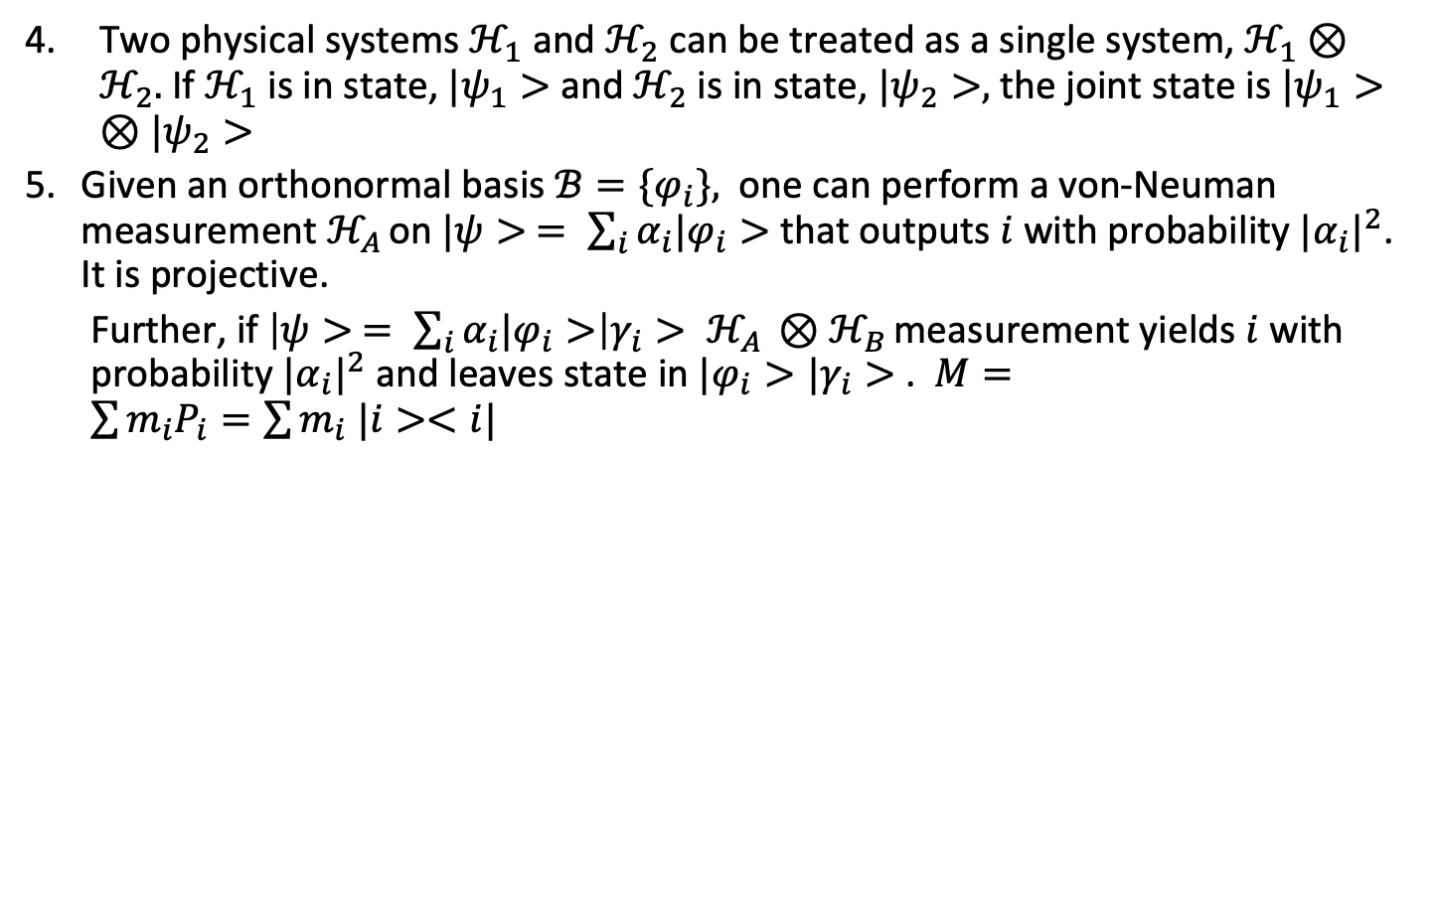
Postulates
Two physical systems $ℋ_{1}$ and $ℋ_{2}$ can be treated as a single system, $ℋ_{1}⊗ℋ_{2}.$ If $ℋ_{1}$ is in state, $|ψ_{1}>$ and $ℋ_{2}$ is in state, $|ψ_{2}>,$ the joint state is $|ψ_{1}>⊗|ψ_{2}>$
Given an orthonormal basis $ℬ=\{φ_{i}\},$ one can perform a von-Neuman measurement $ℋ_{A }$on $|ψ> = \sum_{i}{α_{i}|φ_{i}>}$that outputs $i$ with probability ${|α_{i}|}^{2}$. It is projective.
Further, if $\left|ψ> = \sum_{i}{α_{i}|φ_{i}>}\right|γ_{i}> ℋ_{A }{⊗ℋ}_{B }$measurement yields $i$ with probability ${|α_{i}|}^{2}$ and leaves state in $|φ_{i}>{|γ}_{i}>$. $M=\sum{m_{i}P_{i}=\sum{m_{i} |i><i|}}$

Slide 7
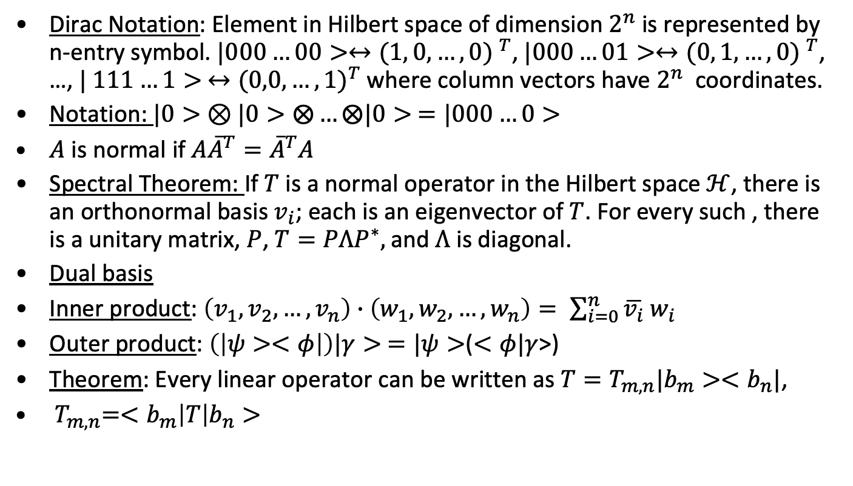
Linear Algebra
Dirac Notation: Element in Hilbert space of dimension $2^{n}$ is represented by n-entry symbol. $|000…00>↔{(1, 0,…,0) }^{T}$, $|000…01>↔{(0, 1,…,0) }^{T}$, …, $| 111…1> ↔{(0,0,…,1)}^{T}$ where column vectors have $2^{n}$ coordinates.
Notation: $|0> ⊗|0>⨂…⨂|0> =|000…0>$
$A$ is normal if $A{\overline{A}}^{T}={\overline{A}}^{T}A$
Spectral Theorem: If $T$ is a normal operator in the Hilbert space $ℋ$, there is an orthonormal basis $v_{i}$; each is an eigenvector of $T$. For every such , there is a unitary matrix, $P$, $T=PΛP^{∗},$and $Λ$ is diagonal.
Dual basis
Inner product: $\left(v_{1},v_{2},…,v_{n}\right)∙\left(w_{1},w_{2},…,w_{n}\right)= \sum_{i=0}^{n}{\overline{v_{i}} w_{i}}$
Outer product: $\left(\left|ψ><φ\right|\right)|γ> =|ψ>$($<φ|γ$>)
Theorem: Every linear operator can be written as $T=T_{m,n}|b_{m}><b_{n}|$,
${ T}_{m,n}=<b_{m}\left|T\right|b_{n}>$

Slide 8
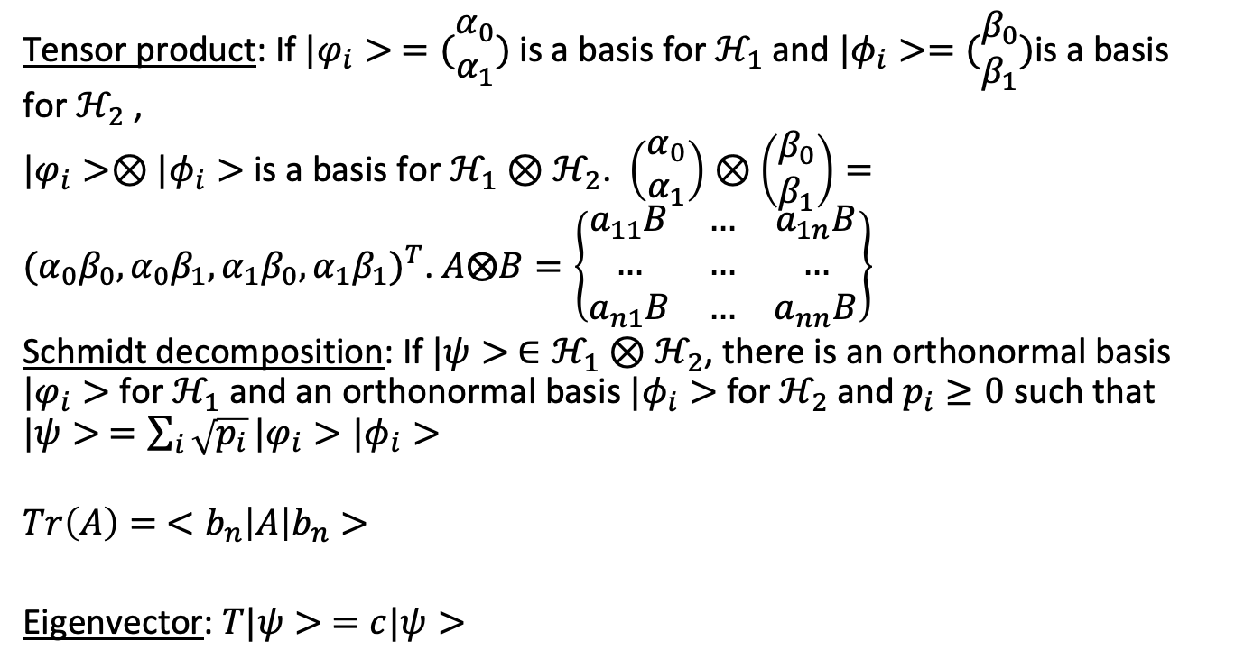
Linear Algebra (continued)
Tensor product: If $|φ_{i}> =(\begin{matrix}α_{0} \\ α_{1}\end{matrix})$ is a basis for $ℋ_{1}$ and $|φ_{i}>=(\begin{matrix}β_{0} \\ β_{1}\end{matrix})$is a basis for $ℋ_{2}$ ,
$|φ_{i}>⊗|φ_{i}>$ is a basis for $ℋ_{1}⊗ℋ_{2}$. $\left(\begin{matrix}α_{0} \\ α_{1}\end{matrix}\right)⊗\left(\begin{matrix}β_{0} \\ β_{1}\end{matrix}\right)={(α_{0}β_{0},α_{0}β_{1},α_{1}β_{0},α_{1}β_{1})}^{T}$. $A⨂B=\left\{\begin{matrix}a_{11}B & … & a_{1n}B \\ … & … & … \\ a_{n1}B & … & a_{nn}B\end{matrix}\right\}$
Schmidt decomposition: If $|ψ> ∈ℋ_{1}⊗ℋ_{2}$, there is an orthonormal basis $|φ_{i}>$ for $ℋ_{1}$ and an orthonormal basis $|φ_{i}>$ for $ℋ_{2}$and $p_{i}≥0$ such that $|ψ> =\sum_{i}{\sqrt{p_{i}}}|φ_{i}>|φ_{i}>$
$$Tr\left(A\right)= <b_{n}\left|A\right|b_{n}>$$
Eigenvector: $T|ψ> =c|ψ>$

Slide 9
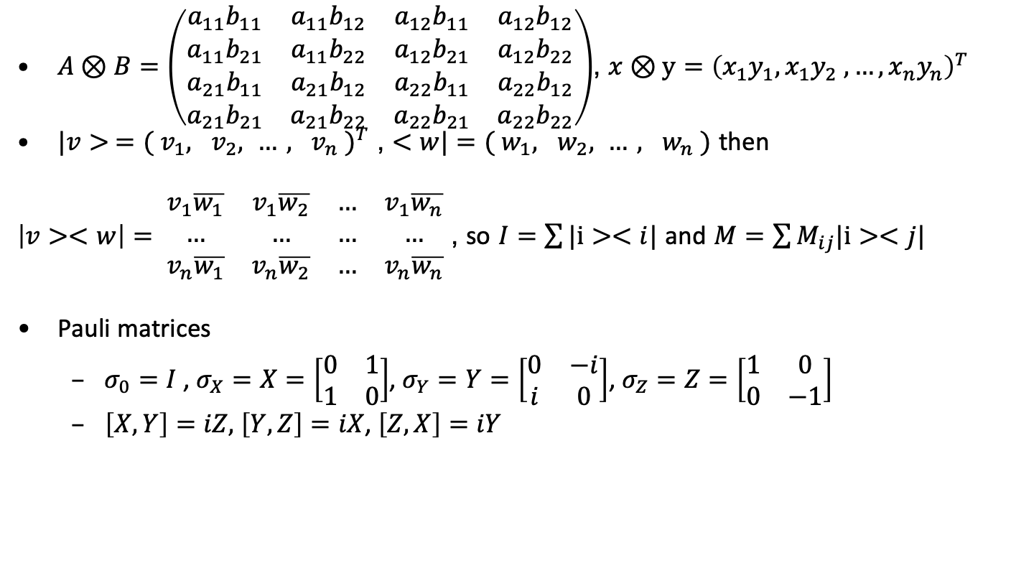
More notation
$A⊗B=\left(\begin{matrix}a_{11}b_{11} & a_{11}b_{12} & a_{12}b_{11} & a_{12}b_{12} \\ a_{11}b_{21} & a_{11}b_{22} & a_{12}b_{21} & a_{12}b_{22} \\ a_{21}b_{11} & a_{21}b_{12} & a_{22}b_{11} & a_{22}b_{12} \\ a_{21}b_{21} & a_{21}b_{22} & a_{22}b_{21} & a_{22}b_{22}\end{matrix}\right)$, $x⊗y={\left(x_{1}y_{1}, x_{1}y_{2} , …,x_{n}y_{n}\right)}^{T}$
$|v> ={( v_{1}, v_{2}, …, v_{n} )}^{T}$ , $<w|=( w_{1}, w_{2}, …, w_{n} )$ then
$\left|v><w\right|= \begin{matrix}v_{1}\overline{w_{1}} & v_{1}\overline{w_{2}} & … & v_{1}\overline{w_{n}} \\ … & … & … & … \\ v_{n}\overline{w_{1}} & v_{n}\overline{w_{2}} & … & v_{n}\overline{w_{n}}\end{matrix}$ , so $I=\sum{|i><i|}$ and $M=\sum{M_{ij}|i><j|}$
Pauli matrices
$σ_{0}=I$ , $σ_{X}=X=\left[\begin{matrix}0 & 1 \\ 1 & 0\end{matrix}\right]$, $σ_{Y}=Y=\left[\begin{matrix}0 & −i \\ i & 0\end{matrix}\right]$, $σ_{Z}=Z=\left[\begin{matrix}1 & 0 \\ 0 & −1\end{matrix}\right]$
$\left[X, Y\right]=iZ,$ $\left[Y,Z\right]=iX$, $\left[Z,X\right]=iY$

Slide 10
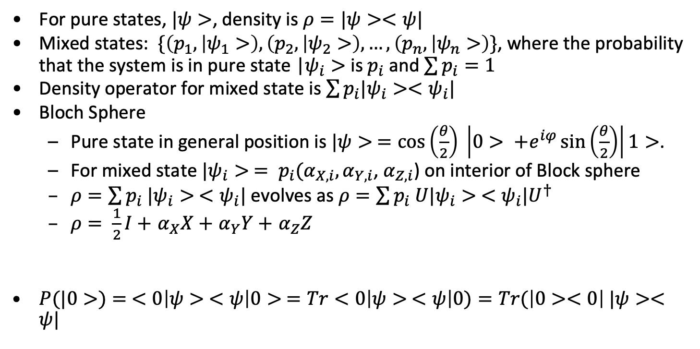
Mixed states and density
For pure states, $|ψ>$, density is $ρ=|ψ><ψ|$
Mixed states: $\{\left(p_{1}, | ψ_{1}>\right),\left(p_{2}, | ψ_{2}>\right),…,\left(p_{n}, | ψ_{n}>\right)\}$, where the probability that the system is in pure state |$ψ_{i}>$ is $p_{i}$ and $\sum{p_{i}}=1$
Density operator for mixed state is $\sum{p_{i}|ψ_{i}><ψ_{i}|}$
Bloch Sphere
Pure state in general position is $|ψ> =\cos\left(\frac{θ}{2}\right) \left|0> +e^{iφ}\sin\left(\frac{θ}{2}\right)\right|1>$.
For mixed state $|ψ_{i}> = p_{i}(α_{X,i},α_{Y,i}$, $α_{Z,i}$) on interior of Block sphere
$ρ=\sum{p_{i} |ψ_{i}> <}$ $ψ_{i}|$ evolves as $ρ=\sum{p_{i} U|ψ_{i}> <}$ $ψ_{i}|U^{†}$
$ρ= \frac{1}{2}I+$ $α_{X}X+$ $α_{Y}Y+$ $α_{Z}Z$
$P(|0>)= <0\left|ψ> <ψ\right|0> =Tr<0\left|ψ> <ψ\right|0)=Tr(\left|0><0\right| |ψ><ψ|$

Slide 11
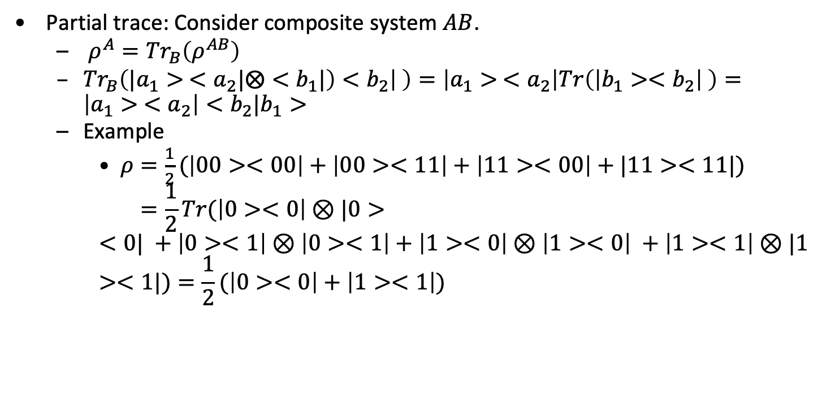
Mixed states and density
Partial trace: Consider composite system $AB$.
$ρ^{A}={Tr}_{B}\left(ρ^{AB}\right)$
${Tr}_{B}\left(|a_{1}> <a_{2}|⨂<b_{1}|\right)<b_{2}\left| \right)=\left|a_{1}> <a_{2}\right|Tr\left(\left|b_{1}><b_{2}\right| \right)=\left|a_{1}> <a_{2}\right|<b_{2}|b_{1}>$
Example
$ρ=\frac{1}{2}(\left|00><00\right|+\left|00><11\right|+\left|11><00\right|+|11><11|)$
$$=\frac{1}{2}Tr(\left|0><0\right|⊗|0><0| +\left|0><1\right|⊗\left|0><1\right|+\left|1><0\right|⊗\left|1><0\right| +\left|1><1\right|⊗|1><1|)=\frac{1}{2}(\left|0><0\right|+\left|1><1\right|)$$

Slide 12
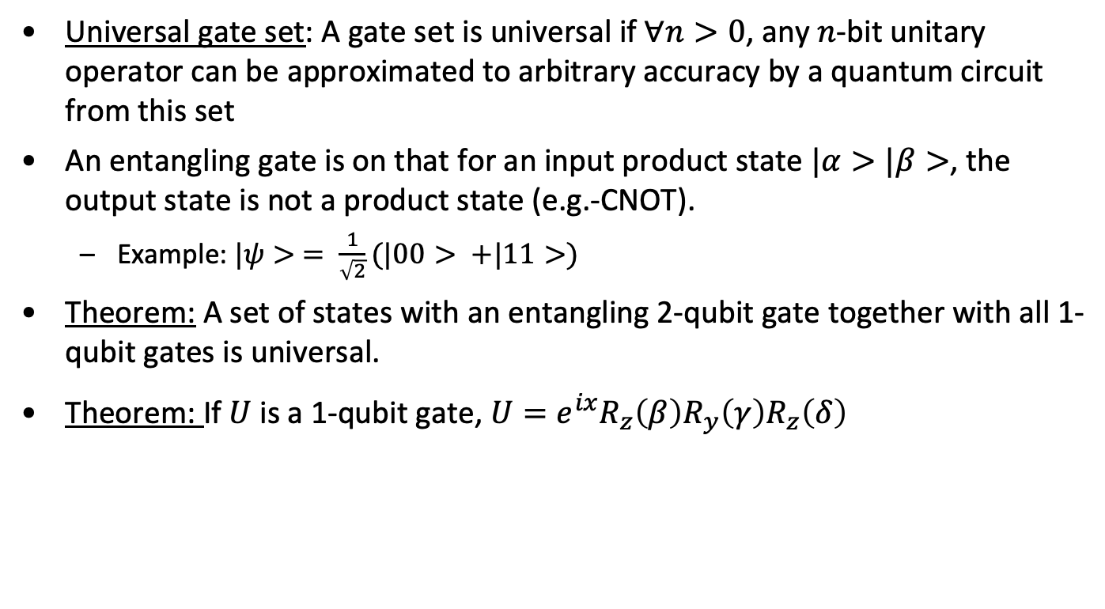
Circuits and gates
Universal gate set: A gate set is universal if $∀n>0$, any $n$-bit unitary operator can be approximated to arbitrary accuracy by a quantum circuit from this set
An entangling gate is on that for an input product state $|α>|β>$, the output state is not a product state (e.g.-CNOT).
Example: $|ψ> = \frac{1}{\sqrt{2}}(|00> +|11>)$
Theorem: A set of states with an entangling 2-qubit gate together with all 1-qubit gates is universal.
Theorem: If $U$ is a 1-qubit gate, $U=e^{ix}R_{z}\left(β\right)R_{y}\left(γ\right)R_{z}\left(δ\right)$

Slide 13
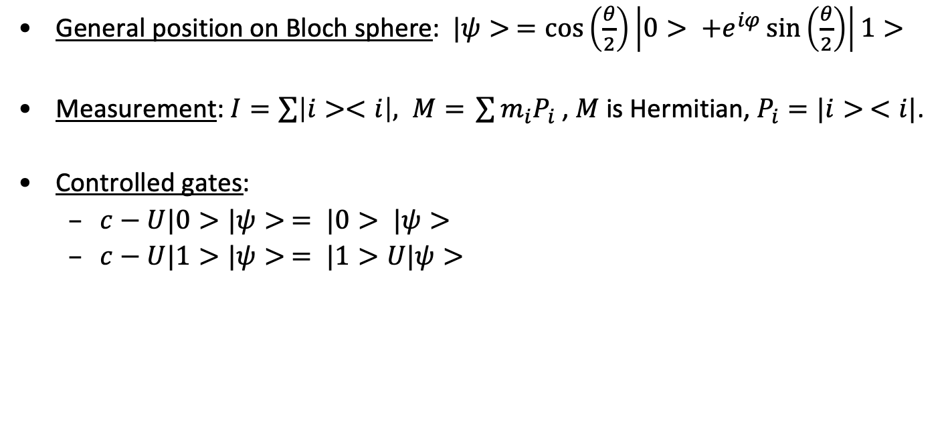
Gates and states
General position on Bloch sphere: $|ψ> =\cos\left(\frac{θ}{2}\right)\left|0> +e^{iφ}\sin\left(\frac{θ}{2}\right)\right|1>$
Measurement: $I=\sum{\left|i><i\right|, M= }\sum{m_{i}P_{i} }$, $M$ is Hermitian, $P_{i}=|i> <i|$.
Controlled gates:
$c−U|0>|ψ> = |0> |ψ>$
$c−U|1>|ψ> = |1>U|ψ>$

Slide 14
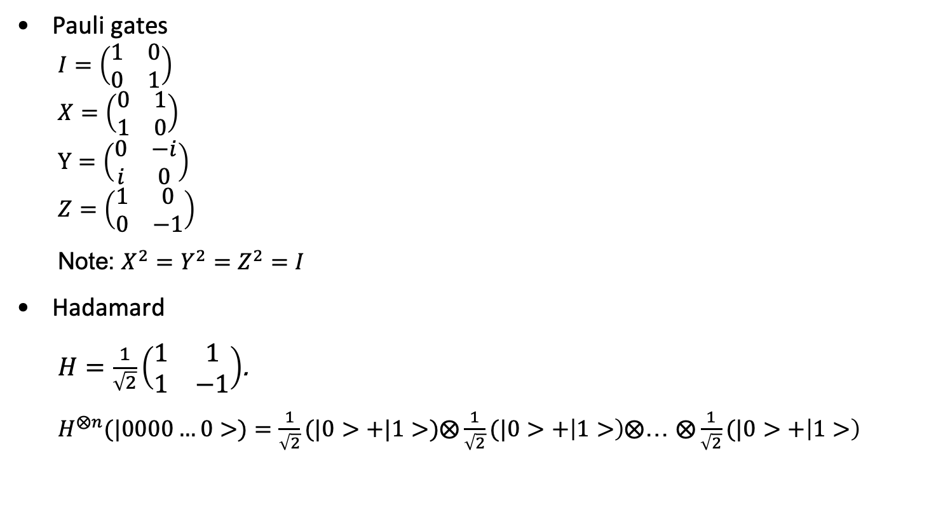
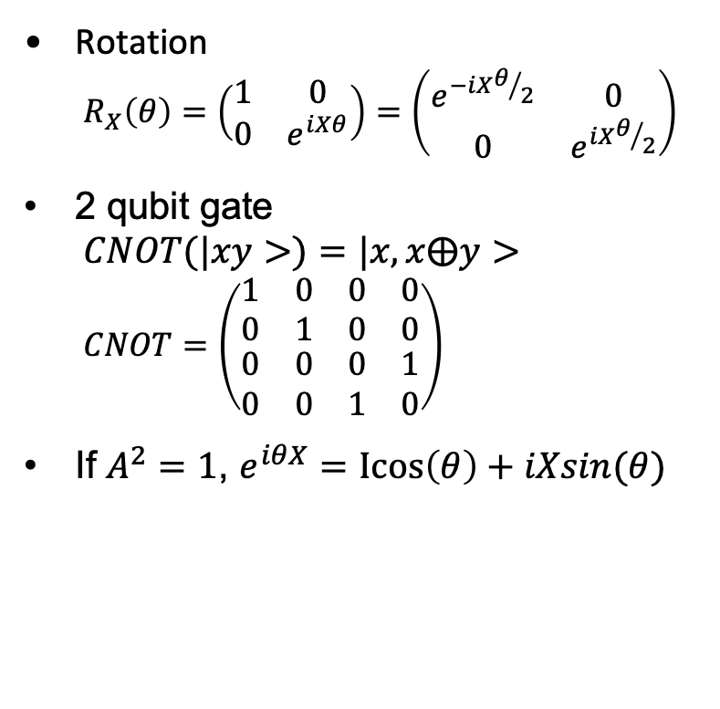
Common gates
Pauli gates
$$I=\left(\begin{matrix}1 & 0 \\ 0 & 1\end{matrix}\right)$$
$$X=\left(\begin{matrix}0 & 1 \\ 1 & 0\end{matrix}\right)$$
$$Y=\left(\begin{matrix}0 & −i \\ i & 0\end{matrix}\right)$$
$$Z=\left(\begin{matrix}1 & 0 \\ 0 & −1\end{matrix}\right)$$
Note: $X^{2}=Y^{2}=Z^{2}=I$
Hadamard
$H=\frac{1}{\sqrt{2}}\left(\begin{matrix}1 & 1 \\ 1 & −1\end{matrix}\right)$.
$H^{⨂n}(|0000…0>)=\frac{1}{\sqrt{2}}(|0>+|1>)⨂\frac{1}{\sqrt{2}}(|0>+\left|1>\right)⨂$… $⨂\frac{1}{\sqrt{2}}(|0>+\left|1>\right)$
Rotation
$$R_{X}\left(θ\right)=\left(\begin{matrix}1 & 0 \\ 0 & e^{iXθ}\end{matrix}\right)=\left(\begin{matrix}e^{−iXθ/2} & 0 \\ 0 & e^{iXθ/2}\end{matrix}\right)$$
2 qubit gate
$$CNOT(|xy>)=|x, x⨁y>$$
$$CNOT=\left(\begin{matrix}\begin{matrix}1 & 0 \\ 0 & 1\end{matrix} & \begin{matrix}0 & 0 \\ 0 & 0\end{matrix} \\ \begin{matrix}0 & 0 \\ 0 & 0\end{matrix} & \begin{matrix}0 & 1 \\ 1 & 0\end{matrix}\end{matrix}\right)$$
If $A^{2}=1$, $e^{iθX}=\operatorname{Icos}\left(θ\right)+iXsin(θ)$

Slide 15
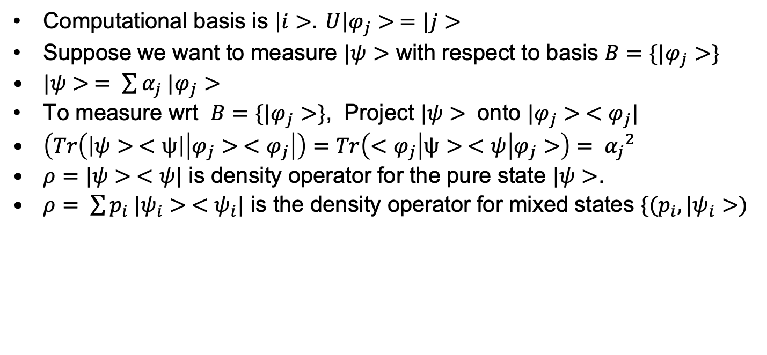
Measurement in alternate basis
Computational basis is $\left|i>. U\right|φ_{j}> =|j>$
Suppose we want to measure $|ψ>$ with respect to basis $B=\{|φ_{j}>\}$
$|ψ> = \sum{α_{j} |φ_{j}>}$
To measure wrt $B=\{|φ_{j}>\}$, Project $|ψ>$ onto $|φ_{j}> <φ_{j}|$
$\left(Tr\left(\left|ψ> <ψ\right|\left|φ_{j}> <φ_{j}\right|\right)=Tr\left(<φ_{j}\right|ψ> <ψ | φ_{j}>\right)= {α_{j}}^{2}$
$ρ=|ψ> <ψ|$ is density operator for the pure state $|ψ>$.
$ρ= \sum{p_{i} |ψ_{i}> <ψ_{i}|}$ is the density operator for mixed states $\{(p_{i},|ψ_{i}>)$

Slide 16
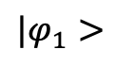
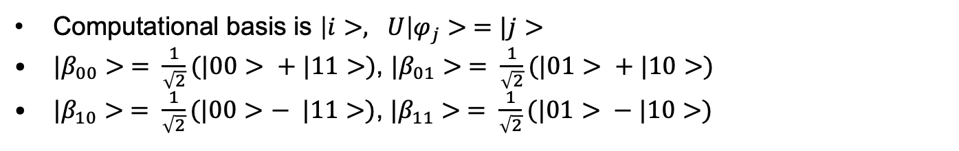

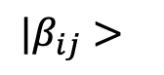
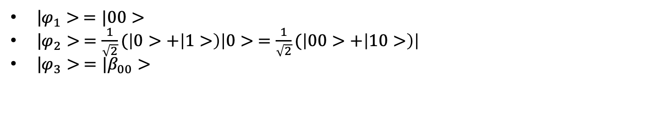
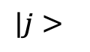
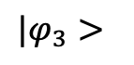
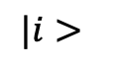
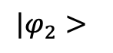
Converting to Bell Basis
Computational basis is $\left|i>, U\right|φ_{j}> =|j>$
${|β}_{00}> = \frac{1}{\sqrt{2}}(|00> + |11>)$, ${|β}_{01}> = \frac{1}{\sqrt{2}}(|01> + |10>)$
${|β}_{10}> = \frac{1}{\sqrt{2}}(|00>− |11>)$, ${|β}_{11}> = \frac{1}{\sqrt{2}}(|01> − |10>)$
$$|i>$$
H
$${|β}_{ij}>$$
$$≡$$
$$|j>$$
X
Bell
$$|φ_{1}>$$
$$|φ_{2}>$$
$$|φ_{3}>$$
|$φ_{1}> =|00>$
|$φ_{2}> =\frac{1}{\sqrt{2}}(\left|0>+\left|1>\right)\right|0> =\frac{1}{\sqrt{2}}(\left|00>+\left|10>\right)\right|$
|$φ_{3}> ={|β}_{00}>$

Slide 17

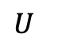
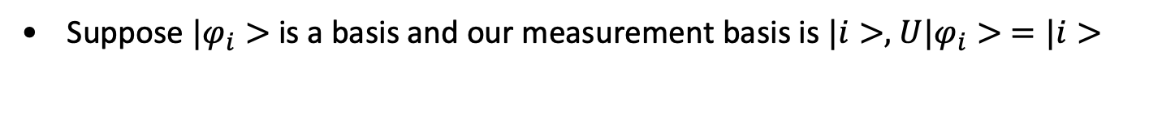
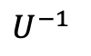
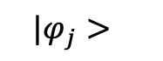
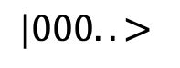
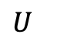
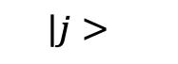
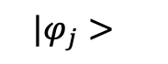

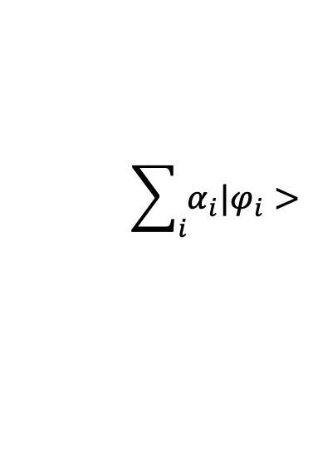
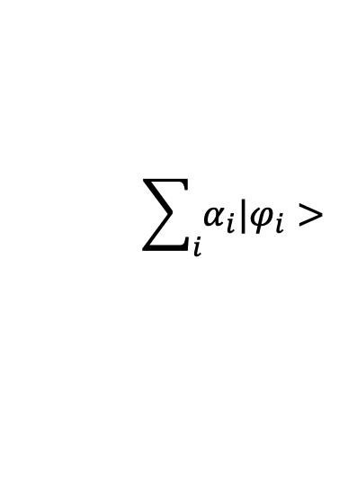
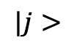
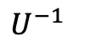
Changing Measurement Basis
Suppose $|φ_{i}>$ is a basis and our measurement basis is $|i>,$ $U|φ_{i}> =|i>$
With probability ${|α_{j}|}^{2}$
$$\sum_{i}{α_{i}|φ_{i}>}$$
$$U$$
$$|j>$$
$$U^{−1}$$
$$|φ_{j}>$$
$$\sum_{i}{α_{i}|φ_{i}>}$$
$$U^{−1}$$
$$|φ_{j}>$$
$$U$$
X
With probability ${|α_{j}|}^{2}$
$$|000..>$$
X
$$|j>$$
X

Slide 18
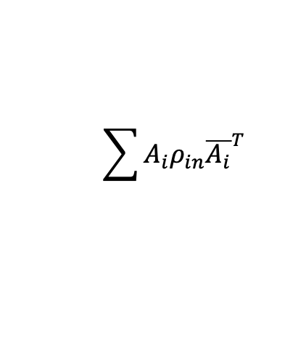
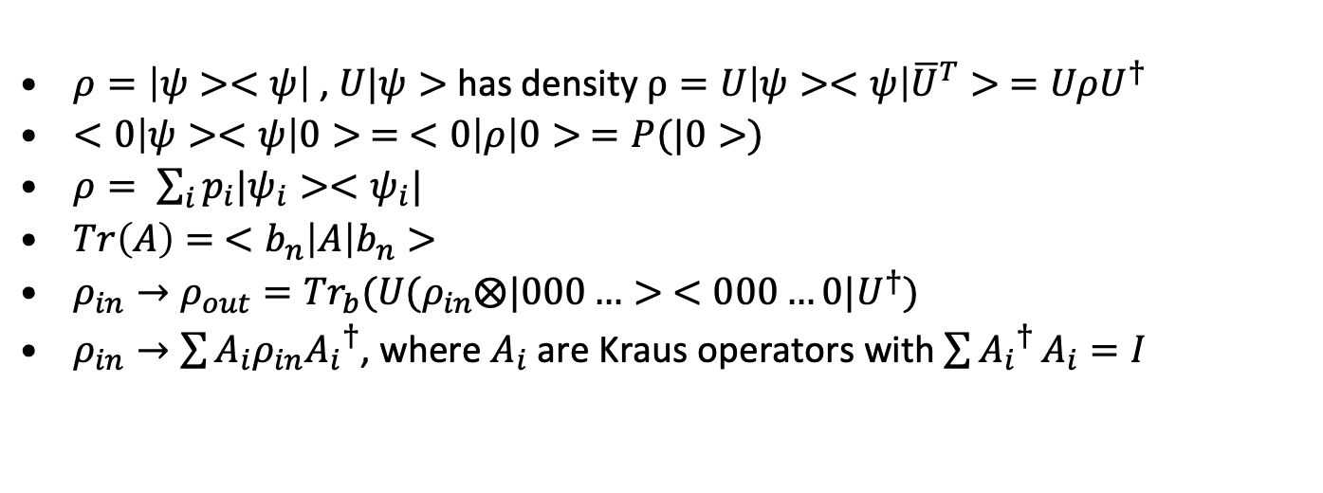
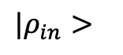
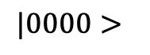
Super-operator and mixed states
$${|ρ}_{in}>$$
$$\sum{A_{i}ρ_{in}{\overline{A_{i}}}^{T}}$$
U
$$|0000>$$
Garbage
$ρ=\left|ψ><ψ\right|$ , $U|ψ>$ has density $ρ=U\left|ψ><ψ\right|{\overline{U}}^{T}> =UρU^{†}$
$<0\left|ψ><ψ\right|0> = <0\left|ρ\right|0> =P(|0>)$
$ρ= \sum_{i}{p_{i}|ψ_{i}><ψ_{i}|}$
$Tr\left(A\right)= <b_{n}\left|A\right|b_{n}>$
$ρ_{in}→ρ_{out}={Tr}_{b}(U(ρ_{in}⨂|000…> <000…0|U^{†})$
$ρ_{in}→\sum{A_{i}ρ_{in}{A_{i}}^{†}}$, where $A_{i}$ are Kraus operators with $\sum{{A_{i}}^{†}}A_{i}=I$

Slide 19
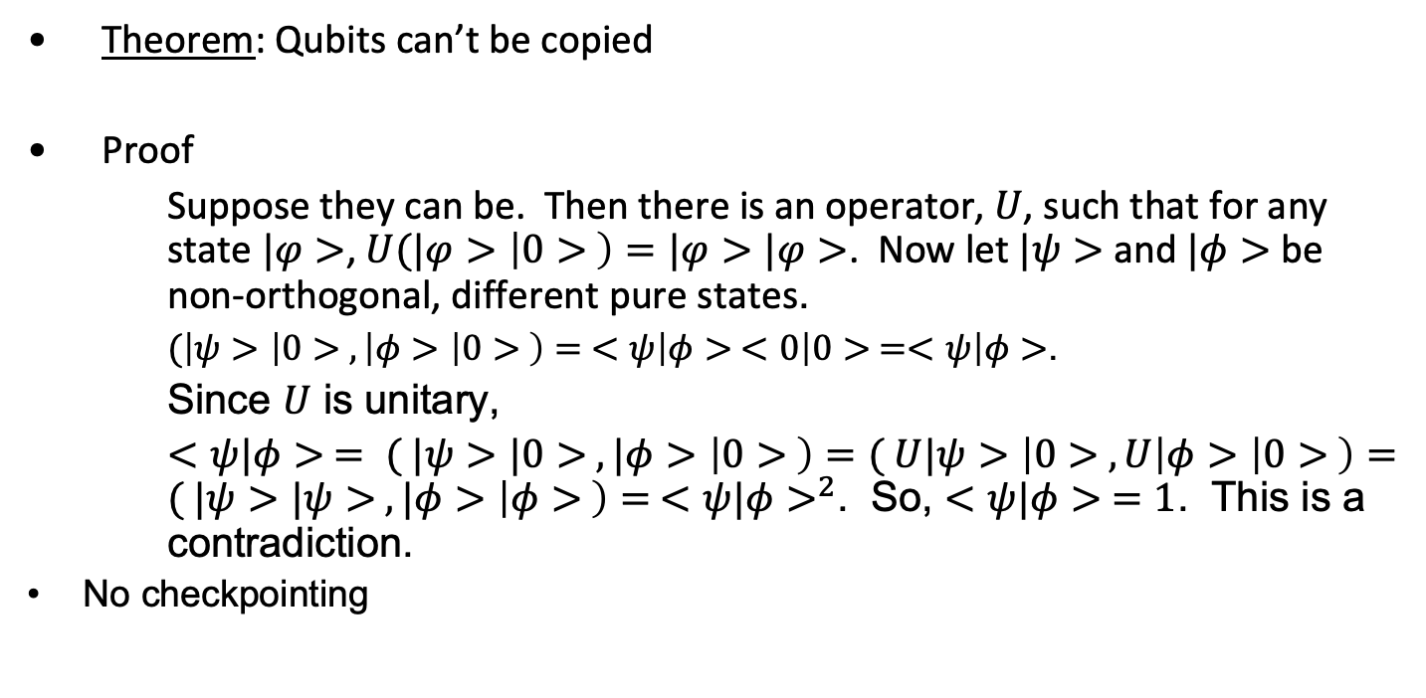
No Cloning Theorem
Theorem: Qubits can’t be copied
Proof
Suppose they can be. Then there is an operator, $U$, such that for any state $|φ>$, $U(|φ>\left|0> \right)=|φ>|φ>$. Now let $|ψ>$ and $|φ>$ be non-orthogonal, different pure states.
$(\left|ψ>\left|0> , \left|φ>\left|0> \right)= <ψ\right|φ> <0\right|0> =<ψ\right|φ>$.
Since $U$ is unitary,
$<ψ|φ> = ( |ψ>|0> , |φ>\left|0> \right)=( U|ψ>\left|0> , U\right|φ>\left|0> \right)=( |ψ>|ψ> , |φ>\left|φ> \right)= {<ψ|φ>}^{2}$. So, $<ψ|φ> =1$. This is a contradiction.
No checkpointing

Slide 20
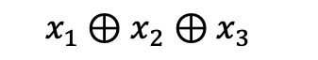
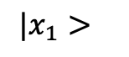
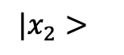
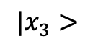
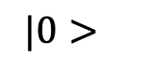
Parity Circuit
$$|x_{1}>$$
$$|x_{2}>$$
$$|x_{3}>$$
$$|0>$$
X
X
X
$$x_{1}⊕x_{2}⊕x_{3}$$

Slide 21
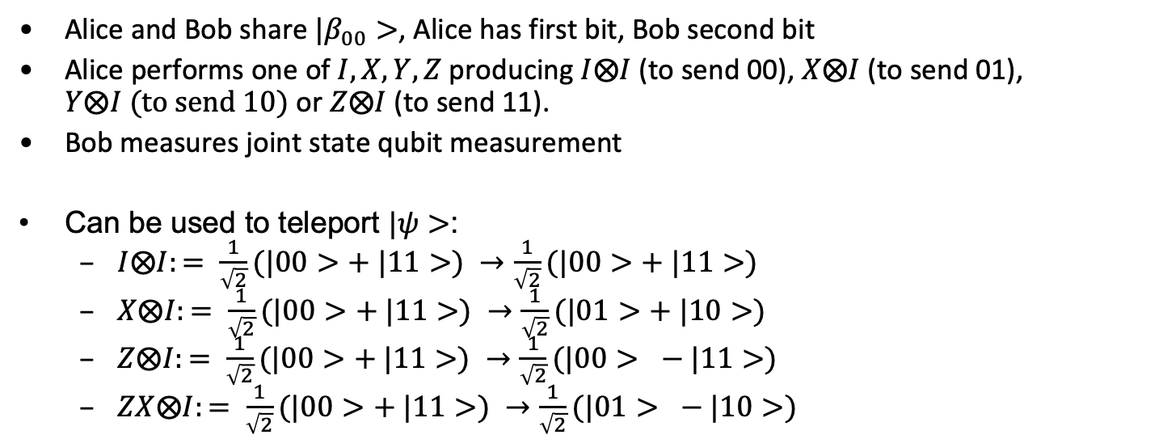
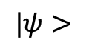
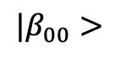
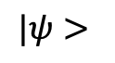
Superdense coding
Alice and Bob share ${|β}_{00}>$, Alice has first bit, Bob second bit
Alice performs one of $I, X,Y,Z$ producing $I⨂I$ (to send 00), $X⨂I$(to send 01), $Y⨂I (to send 10)$ or $Z⨂I$ (to send 11).
Bob measures joint state qubit measurement
Can be used to teleport $|ψ>$:
$I⨂I:= \frac{1}{\sqrt{2}}(|00>+ |11>) →\frac{1}{\sqrt{2}}(|00>+ |11>)$
$X⨂I:= \frac{1}{\sqrt{2}}(|00>+ |11>) →\frac{1}{\sqrt{2}}(|01>+ |10>)$
$Z⨂I:= \frac{1}{\sqrt{2}}(|00>+ |11>) →\frac{1}{\sqrt{2}}(|00> − |11>)$
$ZX⨂I:= \frac{1}{\sqrt{2}}(|00>+ |11>) →\frac{1}{\sqrt{2}}(|01> − |10>)$
$$|ψ>$$
b
Bell
a
$$|β_{00}>$$
X
Z
$$|ψ>$$

Slide 22
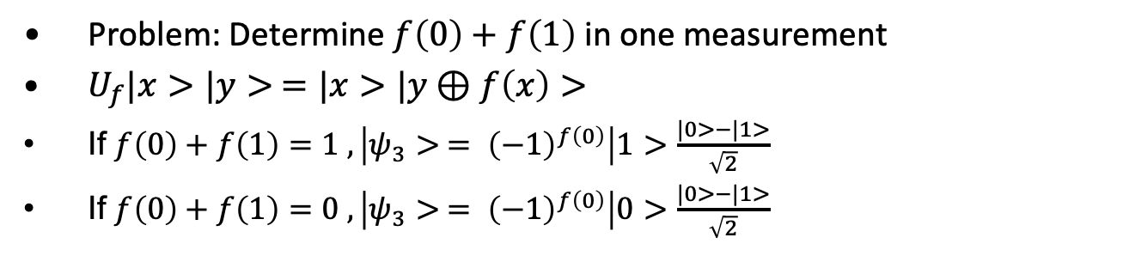
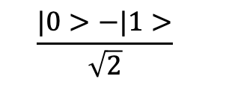
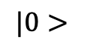
Deutch
Problem: Determine $f\left(0\right)+f\left(1\right)$ in one measurement
$U_{f}|x>|y> =|x>|y⊕f\left(x\right)>$
If $f\left(0\right)+f\left(1\right)=1 , \left|ψ_{3}> = {\left(−1\right)}^{f\left(0\right)}\right|1>$ $\frac{|0>−|1>}{\sqrt{2}}$
If $f\left(0\right)+f\left(1\right)=0 , \left|ψ_{3}> = {\left(−1\right)}^{f\left(0\right)}\right|0>$ $\frac{|0>−|1>}{\sqrt{2}}$
$$|0>$$
H
H
U_{f}
$$\frac{|0>−|1>}{\sqrt{2}}$$

Slide 23










Deutch-Josza
Problem: $f:{\left\{0,1\right\}}^{n}→\left\{0,1\right\}$, which is either constant or balanced.
Which is it?
Put $U_{f}|x>|y> = |x>|y⊕f\left(x\right)>$, $x$ is an n-bit quantity
$$|0>$$
H
H
$$|0>$$
H
H
…
…
$$|0>$$
H
H
$$\frac{|0>−|1>}{\sqrt{2}}$$
$$\frac{|0>−|1>}{\sqrt{2}}$$
U_{f}
$$|φ_{0}>$$
$$|φ_{1}>$$
$$|φ_{2}>$$
$$|φ_{3}>$$

Slide 24

DJ
$|φ_{0}> = {|0>}^{⊗n}\frac{|0>−|1>}{\sqrt{2}}$
$|φ_{1}> = \frac{1}{\sqrt{2^{n}}} \sum_{x}{|x>\frac{|0>−|1>}{\sqrt{2}}}$
$|φ_{2}> = \frac{1}{\sqrt{2^{n}}} \sum_{x}{{(−1)}^{f(x)}|x>\frac{|0>−|1>}{\sqrt{2}}}$
$|φ_{3}> = \frac{1}{2^{n}} \sum_{x}{\sum_{z}{|{(−1)}^{f\left(x\right)+x∙z}z>}\frac{|0>−|1>}{\sqrt{2}}}$

Slide 25

Simon
$f: {\{0,1\}}^{n}→X, ∃ {\vec{s}=s}_{1},s_{2},…,s_{n}$: $f\left(x\right)=f\left(y\right)$ iff $x=y$ or $x=y+\vec{s}$
$U_{f}:|x>|b> =|x>|b⊕f\left(x\right)>$
$H^{⊗n}(|x>)= \frac{1}{\sqrt{2^{n}}}\sum_{z}{{(−1)}^{x∙z} |z>}$
$i=1$
Prepare $\frac{1}{\sqrt{2^{n}}}\sum_{x}{|x>|0>}$
Apply $U_{f}$ to get $\frac{1}{\sqrt{2^{n}}}\sum_{x}{|x>|f(x)>}$
Measure second bit
Apply $H^{⊗n}$ to first register
Measure first register to get $w_{i}$
If $din\left(w_{i}\right)≠n−$1, go to 2
Output s: $w^{t}s^{t}=0$

Slide 26

Phase kick back
$CNOT\left(\frac{|0> +|1>}{\sqrt{2}}\frac{|0> − |1>}{\sqrt{2}}\right)=$ $\frac{|0> − |1>}{\sqrt{2}}$ $\frac{|0> − |1>}{\sqrt{2}}$

Slide 27

Phase Estimation
Phase estimation problem: Given $|ψ> = \frac{1}{\sqrt{2^{n}}}\sum_{y}{e^{2πiωy}|y>}$, estimate $ω$
Theorem: $\frac{x}{2^{n}} ≤ ω ≤$ $\frac{x+1}{2^{n}}$ with probability $≥\frac{8}{π^{2}}$
$e^{2πi2^{k}.x_{1}x_{2}…}=e^{2πi(x_{k+1}x_{k+2}…)}$
Suppose $ω=.x_{1},$ $|ψ> = \frac{1}{\sqrt{2}}\sum_{|y>}{e^{2πiω|y>}}=\frac{1}{\sqrt{2}}(\left|0>+{\left(−1\right)}^{x_{1}}\right|1>$ and $H(|ψ>)$ $=|x_{1}>$
In general, $H^{⊗n}(|x>)=\frac{1}{\sqrt{2^{n}}}\sum_{y}{{(−1)}^{x∙y}|y>}$ and ${H^{⊗n}(H}^{⊗n}(|x>))=|x>$
So, $|ψ> = \frac{1}{\sqrt{2^{n}}}\sum_{|y>}{e^{2πiωy>}|y>}=\frac{1}{\sqrt{2}}(\left|0>+ e^{2πi2^{n−1}ω}\right|1>)⊗\frac{1}{\sqrt{2}}(\left|0>+ e^{2πi2^{n−2}ω}\right|1>)⊗…⊗\frac{1}{\sqrt{2}}(\left|0>+ e^{2πiω}\right|1>)$
Denote $R_{n}=\left(\begin{matrix}1 & 0 \\ 0 & e^{2πi2^{−n}}\end{matrix}\right)$

Slide 28

Quantum Fourier Transform
$H^{⊗n}(|x>)=\frac{1}{\sqrt{2^{n}}}\sum_{y}{{(−1)}^{x∙y}|y>}$
${H^{⊗n}(H}^{⊗n}(|x>))=|x>$
${QFT}_{m}(|x>)=\frac{1}{\sqrt{m}}\sum_{y=0}^{m−1}{e^{{2πi}/m(x∙y)}|y>}$
${{QFT}_{m}}^{−1}(|x>)=\frac{1}{\sqrt{m}}\sum_{y=0}^{m−1}{e^{−{2πi}/m(x∙y)}|y>}$

Slide 29






Quantum Fourier Circuit
…
$$\frac{1}{\sqrt{2}}(\left|0>+e^{2πi\left(0.x_{1}x_{2}…x_{n}\right)}\right|1> )$$
$$|x_{1}>$$
H
R₂
R₃
R_{n}
$$|x_{2}>$$
H
R₂
R₃
…
R_{n-1}
$$\frac{1}{\sqrt{2}}(\left|0>+e^{2πi\left(0. x_{2}…x_{n}\right)}\right|1> )$$
…
$$|x_{n}>$$
$$\frac{1}{\sqrt{2}}(\left|0>{+e}^{2πi\left(0. x_{n}\right)}\right|1> )$$
H

Slide 30













Eigenvalue Estimation
Suppose $|ψ>$ is an eigenstate of a unitary operator, $U$, so $U \left|ψ> =exp\left(2πiφ\right)\right|ψ>.$ $|φ> = .x_{1}x_{2}…x_{n}$ (a binary expansion)
$\frac{1}{\sqrt{2}}(\left|0>+\exp\left(2πi{ω2}^{n−1}\right)\right|1>$)
$$|0>$$
H
$$\frac{1}{\sqrt{2}}(\left|0>+\exp\left(2πi{ω2}^{n−2}\right)\right|1>)$$
H
$$|0>$$
$$ξ$$
…
$$\frac{1}{\sqrt{2}}(\left|0>+\exp\left(2πiω2^{0}\right)\right|1>)$$
$$|0>$$
H
$$|ψ>$$
$$U^{2^{n−1}}$$
$$U^{2^{n−2}}$$
…
$$U^{2^{0}}$$
$$|ψ>$$

Slide 31

Eigenvalue Estimation
$U|ψ> =\exp\left(2πiφ\right) |ψ>$, so$U^{2^{j}}|ψ> =\exp\left(2πiφ2^{j}\right) |ψ>.$
Applying ${{QFT}_{n}}^{−1}$ to $ξ$, gives $<x_{n}, x_{n−1}, …,x_{1}>$ , where $|φ> =.x_{1}x_{2}…x_{n}$
Measure $χ$to get $φ$
$\frac{y}{2^{n}}$ is a good estimate for $φ= \frac{j}{r}$
.

Slide 32

Factorization using order finding (Shor)
Suppose $N=pq$ and $a^{r}=1 (mod N)$ then $r=0 \left(mod φ\left(pq\right)\right)$
If $r$ is even, say, $r=2s$, $\left(a^{s}+1\right)\left(a^{s}−1\right)=0 (mod pq)$.
There is a good chance $p|\left(a^{s}−1\right)$ but $\left(q,\left(a^{s}−1\right)\right)=1.$
Then $\left(\left(a^{s}−1\right), N\right)=p$. Voila!
Note that $|v_{t}> =\frac{1}{r}\sum_{k=0}^{r−1}{exp⁡(−\frac{2πikt}{r})|k\left(mod N\right)>}$ is an eigenvalue of $U_{x} \left(k\right)=|xk \left(mod N\right)>$.
In Shor, $|1> =\frac{1}{\sqrt{r}}\sum{|v_{t}>}$.
Applying ${QFT}^{−1}$ to control gives phase of eigenvalues
Measurement of target gives $|\frac{s}{r}>$ with $\operatorname{Pr}{(|y>)}=\frac{1}{2^{2n}} {|\frac{1−r^{2^{n}}}{1−r}|}^{2}$, where $r=exp⁡(−2πi(\frac{y}{2^{n}}−φ))$

Slide 33

Order Finding
Problem: Given $a, N ∈ℤ$ with $\left(a,N\right)=1$, find $r: a^{r}\left(mod N\right)=1$
Choose $n: 2^{n}≥2r^{2}$
Initialize control register ${|000…0> =|0>}^{⊗2n}$
Initialize target register to $=|000…01> ={|000…0> =|0>}^{⊗2n} ⊗|1>$
Apply $QFT$ to control register
Apply $c−{U_{a}}^{x}$ to control and target register
Apply ${QFT}^{−1}$ to control register
Measure CR to get estimate of $\frac{x_{1}}{2^{n}}$ of multiple of $\frac{1}{r}$
Use continued fraction to get $c_{1}, r_{1}$: $\left|\frac{x_{1}}{2^{n}}−\frac{c_{1}}{r_{1}}\right|≤ 2^{−{(n−1)}/2}$
Repeat 1-8 to get $c_{2}, 2$: $\left|\frac{x_{2}}{2^{n}}−\frac{c_{2}}{r_{2}}\right|≤ 2^{−{(n−1)}/2}$, if none, FAIL
Compute $r=LCM(r_{1},r_{2})$ and $a^{r} (mod N)$
If $a^{r} \left(mod N\right)=1$, output $r$, otherwise FAIL

Slide 34

Order Finding
Order finding has quantum complexity $O({\lg\left(N\right)}^{2}\lg\left(\lg\left(N\right)\right)lg⁡(lg⁡(\lg\left(N\right))$
Classical complexity is $exp⁡(O(\sqrt{\lg\left(N\right)lg⁡(\lg\left(N\right)))}$

Slide 35












Discrete log
Suppose $a=b^{x} (mod p)$, $b$ has known order. We want $r: b^{r}=1\left(mod p\right)$
Put $U_{a}\left( | x>\right)=|ax \left(mod p\right)>$and $U_{b}\left( | x>\right)=|bx \left(mod p\right)>$.
Consider the circuit below. $|1> = \frac{1}{\sqrt{r}}\sum{|v_{t}>}$. Below, $t=xy^{−1}$
$${QFT}^{−1}$$
$$\frac{k}{r}$$
$${|0>}^{⊗n}$$
$$QFT$$
$${|0>}^{⊗n}$$
$$QFT$$
$${QFT}^{−1}$$
$$\frac{kt}{r}$$
$$|1>$$
$${U_{a}}^{x}$$
$${U_{b}}^{x}$$
$$χ$$

Slide 36

Discrete log
Measuring first control register gives $|\frac{k}{r}>$
Measuring first control register gives $|\frac{kt}{r}>$
Quantum complexity is $O({\lg\left(p\right)}^{2}\lg\left(\lg\left(p\right)\right)lg⁡(\lg\left(\lg\left(p\right)\right))$
Best known classical requires $exp⁡(O(\sqrt{\lg\left(p\right)\lg\left(\lg\left(p\right)\right)})$

Slide 37






Error Correction
$$|b>$$
$$G_{enc}$$
$${ℇ_{i}}^{C}$$
$$ℛ^{C}$$
$$|b>$$
$$|000>$$
Unlike classical error correction, the no cloning theorem restricts codes
$|0>\left|E> → β_{1}\right|0>|E_{1}> + β_{2} |1>|E_{2}>$
$|1>\left|E> → β_{3}\right|0>|E_{3}> + β_{4} |1>|E_{4}>$
$\left|ψ> = α_{0}\right|0> + α_{1}\left|1>→{.α}_{0}β_{1}\right|0>|E_{1}> +α_{0}β_{2}|1>|E_{2}> + α_{1}β_{3} |0>|E_{3}> +α_{1}β_{4} |1>|E_{4}>$
$|ψ> = \frac{1}{2} |ψ>\left(β_{1}\left|E_{1}> + β_{3}\right|E_{3}>\right)+ \frac{1}{2}<Z|ψ>\left(β_{1}\left|E_{1}> − β_{3}\right|E_{3}>\right)$ + $\frac{1}{2}<X|ψ>\left(β_{2}\left|E_{2}> + β_{4}\right|E_{4}>\right)$ + $\frac{1}{2}<XZ|ψ>\left(β_{2}\left|E_{2}> + β_{4}\right|E_{4}>\right)$

Slide 38




Error Correction
$ρ= U_{err}|ψ> <E|{\overline{U_{err}}}^{T}$
$\left|ψ_{enc}> =U_{enc}\right|ψ>|000…>$
$ℰ_{0}=I⊗I⊗I, ℰ_{1}=X⊗I⊗I$
$ℰ_{2}=I⊗X⊗I, ℰ_{3}=I⊗I⊗X$
$ρ:\left|ψ><ψ\right|→\left(1−p\right)\left|ψ><ψ\right|+p X\left|ψ><ψ\right|X>$
$\frac{1}{\sqrt{2}}(|000> +|100>)→\frac{1}{\sqrt{2}}(|000> +|111>)≠\frac{1}{\sqrt{2}}{(|0> +|1>) }^{⊗3}$
3-bit code, Shor 9-bit code
$$|ψ>$$
H
$$|0>$$
X
H
$$|0>$$
X
H

Slide 39

Amplitude Amplification
$|ψ> =A \left|00..0> = \sum_{x}{α_{x}}\right|x>|junk\left(x\right)>$
$\left|ψ> = \sum_{x, good}{α_{x}}\right|x>|junk\left(x\right)> +\sum_{x, bad}{α_{x}|x>|junk\left(x\right)>}$
$|ψ_{good}> = \sum_{x, good}{α_{x} |x>|junk\left(x\right)>}$
$|ψ_{bad}> = \sum_{x, bad}{α_{x} |x>|junk\left(x\right)>}$
$|ψ> = \sqrt{p_{good}} |ψ_{good}> +\sqrt{p_{bad}} |ψ_{bad}> =sin⁡(θ)|ψ_{good}>+cos⁡(θ)|ψ_{bad}>$
$p_{good}={sin⁡(θ)}^{2}$

Slide 40




Grover
Search
Input: $U_{f}$: $f:{\{0,1\}}^{n}→\left\{0,1\right\}$
$f\left(a\right)=1$, $f\left(x\right)=0, x≠a$
$$|ψ_{good}> =w$$
$$|ψ_{bad}> =\frac{1}{\sqrt{N−1}}\sum_{x ≠w}{|x>}$$
$$\frac{1}{\sqrt{2^{n}}} |ψ_{good}> +\sqrt{\frac{2^{n}−1}{2^{n}}} |ψ_{bad}>$$
$$\frac{1}{\sqrt{2^{n}}} |ψ_{good}>|1> +\sqrt{\frac{2^{n}−1}{2^{n}}} |ψ_{bad}>|0>$$
U_{f}
$$|0>$$

Slide 41




Grover
Initialize $n$-qubits $|0000…0>$.
Apply $H^{⨂n}$ to get $\frac{1}{\sqrt{N}}\sum_{x=0}^{N−1}{|x}$
Apply Grover $G$ $\frac{π}{4\sqrt{n}}$ times
Measure output
Search
Input: $U_{f}$: $f:{\{0,1\}}^{n}→\left\{0,1\right\}$
$f\left(a\right)=1$, $f\left(x\right)=0, x≠a$
$$|ψ_{good}> =w$$
$$|ψ_{bad}> =\frac{1}{\sqrt{N−1}}\sum_{x ≠w}{|x>}$$
Algorithm $G$
Apply $U_{f}$
Apply $H^{⨂n}$
Apply $U_{0^{⊥}}$
Apply $H^{⨂n}$
Algorithm${ U}_{0^{⊥}}$
$${ U}_{0^{⊥}}:|x> ⟶−|x>, x≠0$$
$${ U}_{0^{⊥}}:|0> ⟶0|x>$$

Slide 42
End

Slide 43

Strings and thermo
String: $dU=\frac{1}{2}μω^{2}y^{2}dx$, $P\left(t\right)=Z=F\frac{∂ψ}{∂t}$, $v_{φ}=\frac{ω}{k}$, $Z=\frac{T}{v_{φ}}$, $\frac{T}{μ}=ω^{2}$
Power transmitted: $P=\frac{1}{2}μω^{2}A^{2}v_{φ}$
$I=I_{0}{(\frac{sin(β/2)}{β/2})}^{2}$, $P_{R}=\frac{P_{T}G_{R}G_{T}λ^{2}}{{(4πR)}^{2}}$
$Z=\sum_{i}{e^{−βE_{i}}}$, $β=\frac{1}{kT}$, $<E> =\frac{∂(\ln\left(Z\right))}{∂β}$
$∆Q+∆W=∆E$, $∆Q$ – heat in system, $∆W$ - work on system
$W=Q(1−\frac{T}{T_{0}})$, $e=(1−\frac{T_{C}}{T_{H}})$, $S=k ln⁡(Ω)Ω$
$c_{v}=\frac{3}{2}R$
$I\left(λ\right)=\frac{2πhc^{2}}{λ^{5}(\exp\left(\frac{hc}{kλT}\right)−1)}$

Slide 44

EM
$E_{n}=\frac{−13.6}{n^{2}}$, $a_{0}=ε_{0}\frac{h^{2}}{πme^{2}}$, $d_{ n}=\frac{{(2m)}^{3/2}VE^{3/2}}{3πh^{3}}$, $g\left(E\right)=\frac{{(2m)}^{3/2}V}{2πh^{2}}\sqrt{E}$
$∇∙j=−\frac{∂ρ}{∂t}$, $∇∙E=\frac{ρ}{ε_{0}}$, $∇×E=−\frac{∂B}{∂t}$, $∇×B=0$, $c^{2}∇×B=\frac{j}{ε_{0}}+\frac{∂E}{∂t}$
$c^{2}=\frac{1}{ε_{0}μ_{0}}$, $I=σT^{4}$, $D=εE,$ $B=μH$
Solution to $∇^{2}ψ−\frac{1}{c^{2}}\frac{∂^{2}ψ}{{∂t}^{2}}=−s$, $ψ\left(t\right)=\frac{1}{4π}\frac{S(t−\frac{r}{c})}{r}$, $S\left(t\right)=\int{s\left(t\right)dV}$
$φ\left(1,t\right)= \int{\frac{ρ(2,t−\frac{r}{c})}{4πε_{0}r_{12}} dV}$, $A\left(1,t\right)= \int{\frac{ρ(2,t−\frac{r}{c})}{4πc^{2}ε_{0}r_{12}} dV}$
$∇φ=E+\frac{∂A}{∂t}$, $S=ε_{0}c^{2}E×B$
Oscillating dipole: $ψ= \frac{dz}{4πε_{0}}[\frac{q(t−\frac{r}{c})}{r^{3}}+\frac{I(t−\frac{r}{c})}{r^{2}c}]$
$x^{′}=γ(c−ut)$, $t^{′}=γ(t−\frac{ux}{c^{2}})$, $E^{2}+{(pc)}^{2}={( m_{0}c^{2} )}^{2}$

Slide 45

Susskind
$|ψ> =\sum_{i}{α_{i}|λ_{i}>}$ is the state of a system, the $|λ_{i}>$ is a complete set of orthonormal vectors which are eigenvectors
$<L> = \sum_{i}{P(λ_{i})λ_{i}}$ is the expected value
$<L> = <ψ\left|L\right|ψ> = \sum_{i}{\overline{α_{i}}}α_{i}<λ_{i}|λ_{i}>$, $α_{i}∈ℂ$
If $φ,ψ$ are states in a continuous variable, $<φ|ψ> =\int_{−∞}^{∞}{\overline{φ}ψ dx}$
$I=\sum_{i}{|i> <i|}$, $Tr\left(L\right)= \sum_{i}{<i\left|L\right|i>}$, $I=\int{\left|x> <x\right| dx}$
If $|ψ> =\sum_{i}{α_{i}|i>}$ , $<j|$ $ψ> =\sum_{i}{α_{i}<j|i>}$
C-S: $|\vec{x|}$ |$\vec{y|}≥$ $\vec{|x}∙$ $\vec{y|}$, Triangle: $\vec{|x}|+|\vec{y}| ≥|\vec{x}+\vec{y}|$
Eigenvectors of a Hermitian operator are a complete set
Eigenvectors with different eigenvalues are orthogonal.
$<x> = \int{x{|ψ|}^{2}} dx$, $P\left(x≤a≤x+∆x\right)= {|ψ|}^{2}$

Slide 46

Susskind
Observables: $M|λ> = λ |λ>$, $λ$is the observed value, $M$ is projective and Hermitian
The rules
Observables are represented by linear operators. States are vectors
Results of measurements are eigenvalues
Distinguishable states correspond to orthogonal eigenvalues
If $|ψ>$ is a state and and $L$ is an observable,
$$P\left(λ_{i}\right)=<ψ|λ_{i}><λ_{i}|ψ>$$
Evolution of states governed by a unitary operator

Slide 47

Spin
Spin field: $H= σ∙B$
$<{\dot{σ}}_{z}> =\frac{iω}{2}<[σ_{z},σ_{z}]>$, $<{\dot{σ}}_{y}> =−ω<σ_{x}>$
$<{\dot{σ}}_{x}> =\frac{−i}{ℏ}<[σ_{x},H]>$, $<{\dot{σ}}_{y}> =\frac{−i}{ℏ}<[σ_{y},H]>$, $<{\dot{σ}}_{z}> =\frac{−i}{ℏ}<[σ_{z},H]>$
$|u> =\left(\begin{matrix}1 \\ 0\end{matrix}\right)$, $|d> =\left(\begin{matrix}0 \\ 1\end{matrix}\right)$
$|r> =\frac{1}{\sqrt{2}}(|u>+|d>$, $|l> =\frac{1}{\sqrt{2}}(|u> − |d>$
$|i> =\frac{1}{\sqrt{2}}(|u>+i|d>$, $|o> =\frac{1}{\sqrt{2}}(|u> −i |d>$
Pauli matrices: $σ_{z}=\left(\begin{matrix}1 & 0 \\ 0 & −1\end{matrix}\right)$, $σ_{x}=\left(\begin{matrix}0 & 1 \\ 1 & 0\end{matrix}\right)$ , $σ_{y}=\left(\begin{matrix}0 & −i \\ i & 0\end{matrix}\right)$
$σ_{n}=\left(\begin{matrix}cos⁡(θ) & sin⁡(θ) \\ sin⁡(θ) & −cos⁡(θ)\end{matrix}\right)$
$λ_{1}=1$, $|λ_{1}> = \left(\begin{matrix}cos⁡(\frac{θ}{2}) \\ sin⁡(\frac{θ}{2})\end{matrix}\right)$, $λ_{2}=−1$, $|λ_{2}> = \left(\begin{matrix}−sin(\frac{θ}{2}) \\ cos⁡(\frac{θ}{2})\end{matrix}\right)$

Slide 48

Entanglement
Composite: $|φ>∈H^{A}$, |ψ>$∈H^{B}$, $φ⊗ψ∈H^{AB}$
$L|λ_{i},μ_{i}> =λ_{i}|λ_{i},μ_{i}>$, M$|λ_{i},μ_{i}> =μ_{i}|λ_{i},μ_{i}>$ for independent action
If $A$ state coefficients are $a$ and $B$ state coefficients are $B,$
$|φ⊗ψ>=\sum_{a,b}{|φ(a)>⊗|ψ\left(b\right)>} |ab>$
Alice and Bob spins: $(α_{u}\left|u>+α_{d}\right|d>)⊗(β_{u}\left|u>+β_{d}\right|d>)$ as product state
General entangled: $ψ_{uu}\left|uu>+ψ_{ud}\right|ud>+ψ_{du}|du>+ψ_{dd}|dd>$
Entangled: $|sing> =\frac{1}{\sqrt{2}}(|ud> − |du>)$,
$<sing\left|σ_{z}\right|sing> =0$

Slide 49

Susskind and density
$τ_{z}σ_{z}|sing> =−|sing>$, $τ_{x}σ_{x}|sing> =−|sing>$
$<L> =Tr \left(ρL\right)=<ψ\left|L\right|ψ>$ for states prepared with probability $p_{i}$
If $<L> =p_{ψ}<ψ\left|L\right|ψ>+p_{φ}<φ\left|L\right|φ>$, density operator is
$P=p_{ψ}\left|ψ> <ψ\right|{+p}_{φ}|φ><φ|$
$P_{a,a^{′}}= \overline{ψ\left(a\right)}ψ(a^{′})\sum_{b}{\overline{φ(b)} φ(b)}$
$L_{a^{′}b^{′}a,b}= <a^{′}b^{′}\left|L\right|ab>$
$<ψ\left|L\right|ψ> =\sum_{a,a^{′},b,b^{′}}{{\overline{ψ}}_{a^{′},b^{′}}L_{a^{′},a}}ψ_{a,b}$

Slide 50

Uncertainty, Evolution and Schrodinger
Uncertainty: From triangle, $\left(∆X\right)\left(∆Y\right)≥\frac{1}{2}|<ψ|[A,B]|ψ>|$
Unitary evolution: $U^{⊥}\left(t\right)U\left(t\right)=I$, $\left|ψ\left(t\right)> =U\left(t\right)\right|ψ\left(0\right)>$
$U\left(ε\right)=(I+\frac{i}{ℏ}εH)|ψ\left(0\right)>$, so
$\frac{|ψ\left(ε\right)> −|ψ\left(0\right)>}{ε}=−\frac{i}{ℏ}H|ψ\left(0\right)>$, or, $\frac{∂|ψ\left(t\right)>}{∂t}=−\frac{i}{ℏ}H\left|ψ\left(t\right)>\right|$
$\frac{d}{dt}<ψ\left|L\right|ψ> =<\dot{ψ}\left|L\right|ψ>+<ψ\left|L\right|\dot{ψ}> =$
$\frac{i}{ℏ}(<ψ\left|HL\right|ψ> −\left(<ψ\left|LH\right|ψ>\right)=\frac{i}{ℏ}<ψ\left|\left[H,L\right]\right|ψ>$
This gives conservation of energy since $\left[H,H\right]=0$
Example: $H=\frac{ℏω}{2}σ∙n$

Slide 51

Momentum space and Fourier
$P|ψ> =p|ψ>$ is equivalent to $P=−iℏ\frac{∂}{∂x}$
Eigenvectors are solutions of $−iℏ\frac{∂ψ}{∂x}=pψ$, $ψ_{p}\left(x\right)=Aexp(i\frac{px}{ℏ})$
Wavelength of $Aexp(i\frac{px}{ℏ})$ is $λ=\frac{2πℏ}{p}$
$P\left(p\right)= {\left|<P\right|ψ>|}^{2}$, put $\tilde{ψ}\left(p\right)=<P|ψ>$
$\tilde{ψ}\left(p\right)=\int{dx<p\left|x><x\right|ψ>}$but $ψ\left(x\right)=<x|ψ>$ and
$<p|x> = \frac{1}{\sqrt{2π}}exp⁡(−i\frac{px}{ℏ})$
Similarly, $ψ\left(x\right)=<x|ψ> =\int{dp<x\left|p><p\right|ψ>}$ and
$ψ\left(x\right)=\frac{1}{\sqrt{2π}}\int{dp exp⁡(i\frac{px}{ℏ})\tilde{ψ}(p)}$
$ψ\left(x\right)=\frac{1}{\sqrt{2π}}\int_{−∞}^{∞}{exp⁡(i\frac{px}{ℏ})\tilde{ψ}(p)\text{dp} }$,
$\tilde{ ψ}(p)=\frac{1}{\sqrt{2π}}\int{\exp\left(−i\frac{px}{ℏ}\right) ψ\left(x\right)dx}$

Slide 52

Susskind
$ψ\left(x,t\right)=\operatorname{Aexp}\left(i\frac{px−\frac{p^{2}t}{2m}}{ℏ}\right)$ is a complete set of solutions
$ψ\left(x,t\right)=\int{dp \tilde{ψ}(p)}$ $\exp\left(i\frac{px−\frac{p^{2}t}{2m}}{ℏ}\right)$
Dynamics:
X$|ψ> =x |ψ>$, $P\left|ψ> =iℏ\frac{∂}{∂x}\right|ψ>$
$V|ψ> →V(x)ψ(x)ψ$, get $Eψ=−\frac{ℏ^{2}}{2m}\frac{∂^{2}ψ}{{∂x}^{2}}+V(X)ψ$
$<v> = \frac{d}{dt}<ψ\left|X\right|ψ>$,
$\frac{d}{dt}<P> = \frac{i}{ℏ}\left[V,P\right]=−<\frac{∂V}{∂x}>$,
$\left[V,P\right]=iℏ\frac{dV}{dt}$

Slide 53

Standard solution
Standard method:
Get $H$
Prepare $|ψ\left(0\right)>$
Find $H\left|E_{j}> = E_{j} \right|E_{j}>$
$α_{j}\left(0\right)=<E_{j}|ψ\left(0\right)>$, $α_{j}\left(t\right)=α_{j}\left(0\right)exp⁡(−i\frac{E_{j}t}{ℏ})$
$|ψ\left(t\right)> = \sum_{j}{α_{j}\left(t\right)} |E_{j}>$
$P_{λ}\left(t\right)={<λ|ψ\left(t\right)>}^{2}$
Correlation and means
${∆A}^{2}= \sum_{a}{{\left(A−\overline{A}\right)}^{2}}P\left(a\right)= {\left|<A^{2}\right|ψ>|}^{2}$
$\left(∆A\right)\left(∆B\right)≥ \frac{1}{2}{\left|<ψ\right|[A,B]|ψ>}^{2}$
$C\left(A,B\right)= <AB> − <A><B>$
$C(σ_{x}{, τ}_{x})$= -1

Slide 54

Harmonic Oscillator, etc
$H=\frac{1}{2}{\dot{X}}^{2}+\frac{1}{2}ω^{2}x^{2}=\frac{P^{2}+w^{2}x^{2}}{2}=\frac{1}{2}\left(P+iωX\right)\left(P−iωX\right)−ω^{2}[X,P]$
Ground state: $ψ\left(x\right)=exp⁡(\frac{ω}{2ℏ}x^{2})$, $E_{0}=\frac{ωℏ}{2}$
$a^{−}=\frac{i}{\sqrt{2ωℏ}}(P−iωX)$, $a^{+}=\frac{−i}{\sqrt{2ωℏ}}(P+iωX)$
$\left[a^{−},a^{+}\right]=1$. If $N=a^{+}a^{−}$, $H=ωℏ(N+\frac{1}{2})$, $N\left|n> =n\right|n>$,
$a^{+}|n> =|n+1>$
Particle in box: $E_{n}=\frac{n^{2}h^{2}}{8mL^{2}}$, $ψ_{n}=Csin(\frac{nπx}{L})$

Slide 55

Multi-particle systems
Two particles: $ψ(r_{1},r_{2},t)$
$H=−\frac{ℏ^{2}}{2m_{1}}∇_{1}^{2}−\frac{ℏ^{2}}{2m_{2}}∇_{2}^{2}+V(r_{1},r_{2},t)$
Product state, particle 1 in state a, particle 2 in state b: $ψ\left(r_{1},r_{2}\right)=ψ_{a}(r_{1})∙ψ_{b}(r_{2})$
$ψ_{±}\left(r_{1},r_{2}\right)=A[ψ_{a}(r_{1})∙ψ_{b}(r_{2})±ψ_{a}(r_{2})∙ψ_{b}(r_{1})]$
Bosons: + sign, Fermions: - sign
For fermions, if both have same state, $ψ_{−}\left(r_{1},r_{2}\right)=0$
$ψ\left(r_{1},r_{2}\right)=±ψ\left(r_{2},r_{1}\right)$, + for bosons, - for fermions
Distinguishable and indistinguishable particles
Free electron gas in lattice $(k_{x},k_{y},k_{z})$
$E_{F}=\frac{ℏ^{2}}{2m}{(3ρπ^{2})}^{2/3}$, $dE=\frac{ℏ^{2}k^{2}}{2m}\frac{V}{π^{2}}k^{2} dk$

Slide 56

Quantum Field Theory
$E_{n}=ℏω(n+\frac{1}{2})$, $p=\frac{h}{λ}=ℏk$
For a given wave number, number of particles is the exitation number (n)
$|ψ(x)> =\int{dx ψ\left(x\right)|x>}$, $|ψ(x_{1},x_{2})> =\int{dx_{1}dx_{2} ψ\left(x_{1},x_{2}\right)|x_{1},x_{2}>}$
Procedure: Express field in wave number Fourier space, exitations corresponding to wave numbers correspond to particles
$E=\int{ρ dV}$, $ρ=\frac{1}{2}{( ∂_{t}φ )}^{2}+\frac{1}{2}{( ∂_{x}φ )}^{2}+V(φ)$, $φ$ a free field
$φ\left(x,t\right)=\sum_{k}{α_{k}\left(t\right)e^{−ikx}}$
$\tilde{p}\left(k\right)=\frac{1}{2}{( ∂_{t}a )}^{2}+\frac{1}{2}ak^{2}+\frac{1}{2}a^{2}k^{2}$, $ω^{2}=k^{2}+m^{2}$
Free scalar field is infinite collection of harmonic oscillators

Slide 57

QFT
$P\left(\left\{φ\left(x\right)\right\}\right)= {|ψ(\{φ(x)\}|}^{2}$, probability is for entire field
Coupling constant for QED is $\sqrt{α}$, $α≈\frac{1}{137}$ is fine constant
Find Lagrangian density and integrate to get Lagrangian
$ℒ=\frac{1}{2}{( ∂_{t}φ )}^{2}−\frac{1}{2}{\left( ∂_{x}φ \right)}^{2}−\frac{1}{2}{( m_{φ} )}^{2}φ^{2}$
With interactions: $ℒ=\frac{1}{2}{( ∂_{t}φ )}^{2}−\frac{1}{2}{\left( ∂_{x}φ \right)}^{2}−\frac{1}{2}{\left( m_{φ} \right)}^{2}φ^{2}+\frac{1}{2}{\left( ∂_{t}θ \right)}^{2}−\frac{1}{2}{\left( ∂_{x}θ\right)}^{2}−\frac{1}{2}{\left( m_{θ} \right)}^{2}θ^{2}−Aφ^{2}θ−Bφ^{2}θ^{2}$
$A,B$ are coupling constants
$V\left(φ\right)=μ^{2}φ^{2}+λφ^{4}$ for “sombrero” potential

Slide 58

Quantum Field Theory
Path Integrals
$U\left(ε\right)=e^{−iεt}$,
$C_{1,2}=\int{dx }<x_{2}|e^{−i\frac{H}{2}t}|x><x|e^{−i\frac{H}{2}t}|x_{1}>$
$<x_{2}\left|U^{N}\right|x_{1}>$ is evolution over small time slices
$C_{1,2}=\int{e^{iA/ℏ}}$, integral is over all paths
$ℒ_{QED}=−\sqrt{α}e^{−}e^{+}γ$, $ℒ_{int}=cφ^{4}$

Slide 59

Symmetries
Translational symmetry: $Vψ\left(x−ε\right)= ψ\left(x\right)−i\frac{ε}{ℏ}\frac{∂ψ}{∂x}$
$\hat{V}=\left(1−i\frac{ε}{ℏ}\frac{∂}{∂x}\right)=(1+i\frac{ε}{ℏ}\hat{p_{x}})$. Generator of symmetry group is $\frac{p_{x}}{ℏ}$
Noether: If $φ→φ+Dφ$ changes $ℒ$ by $Dℒ=∂_{μ}W^{μ}$ then $J_{N}^{μ}=\prod_{μ}{Dφ−W^{μ}(x)}$ then $∂_{μ}J_{N}^{μ}=0$. Continuous symmetries conserve currents.
$U:|ψ_{1}>=ψ_{2}$, $V:|ψ> →|ψ^{′}>$
$UV |ψ_{1}> =|ψ_{2}^{′}>$ , $UV=VU$
$V\left(ε\right)=1−iεG$

Slide 60

Symmetries
Translational symmetry: $Vψ\left(x−ε\right)= ψ\left(x\right)−i\frac{ε}{ℏ}\frac{∂ψ}{∂x}$
$\hat{V}=\left(1−i\frac{ε}{ℏ}\frac{∂}{∂x}\right)=(1+i\frac{ε}{ℏ}\hat{p_{x}})$. Generator of symmetry group is $\frac{p_{x}}{ℏ}$
Noether: If $φ→φ+Dφ$ changes $ℒ$ by $Dℒ=∂_{μ}W^{μ}$ then $J_{N}^{μ}=\prod_{μ}{Dφ−W^{μ}(x)}$ then $∂_{μ}J_{N}^{μ}=0$. Continuous symmetries conserve currents.
Rotational symmetries: $ψ(θ)→ψ(θ−ε)$ then $δψ=−ε\frac{∂ψ}{∂θ}$.
Rewrite as: $δψ=(−iε)(−\frac{i}{ℏ} \frac{∂ψ}{∂θ})$ so $−\frac{i}{ℏ}\frac{∂}{∂θ}→L_{z}$. $δψ=(−iℏ\frac{∂}{∂θ})ψ$ and $L_{z}$ is a generator
$L_{z} |ψ> =m|ψ>$ for spin: $M\left(ψ\left(θ\right)\right)= ψ(−θ)$. $LM≠ML$
If $A, B$ are symmetries, so is $\left[A,B\right]=iC$. Group operation in the Lie group is $(A,B)→C$

Slide 61

Symmetries
Let $\left(x, y\right)→(x+δx, y+δy)$ by a small rotation, $ε.$ $δx=−εy$, $δy=εx$. $δψ=−\frac{∂ψ}{∂x}εy+\frac{∂ψ}{∂y}εx=iεL_{z}ψ$
$L_{z} |m> =m |m>$
Define $L_{+}=L_{x}+iL_{y}$ and $L_{−}=L_{x}−iL_{y}$
$\left(L_{+}L_{z}−L_{z}L_{+}\right)\left|m> =−L_{+}\right|m>$
$\left(m+ 1\right)L_{+} \left|m\right\rangle = L_{z}L_{+}\left|m\right\rangle$
$\left(m−1\right)L_{−}|m>L_{z}L_{−}\left|m\right\rangle$
Apply Hamiltonian: ${HL}_{+} \left|m\right\rangle =L_{+}H\left|m> =EL_{+}\right|m>$
$H\left|m+1> =E\right|m+1>$

Slide 62

Fundamental Forces
Spin 0 corresponds to scalar described by scalar field dynamics modeled by Klein Gordan equation
Spin $\frac{1}{2}$ corresponds to spinor described by spinor field dynamics modeled by Dirac equation
Spin 1, massless corresponds to vector described by massive gauge field dynamics modeled by Proca equation
Spin 0 massive corresponds to vector described by massless gauge field dynamics modeled by Maxwell equation

Slide 63

QFT
$\left[X, \left[Y,Z\right]\right]+\left[Z,\left[X,Y\right]\right]+\left[Y,\left[Z,X\right]\right]=0$
$a^{±}=\frac{P±iωX}{\sqrt{2ω}}$, $N=a^{+}a^{−}+E_{0}$, $N$ is number operator, $E_{0}$ is ground state
$H=ℏωN$, $N |n> =n |n>$
$\left[a^{±},a^{±}\right]=0$, $\left[a_{i}^{−},a_{j}^{+}\right]=δ_{ij}$
$|n_{1}n_{2}…n_{k}>$ $i$th state has $n_{i}$particles, $E_{T}=\sum_{i}{ℏn_{i}ω_{i}+E_{0}}$
$a^{+}\left|n> =\sqrt{n+1}\right|n+1>$, $a^{−}|n> =|n−1>$
$a_{s}^{+}|n_{1}n_{2}…n_{k}> =\sqrt{n_{s}+1}|n_{1}n_{2}, n_{s−1}, n_{s}+1,…n_{k}>$
Definition: $Ψ^{†}=\sum_{i}{a_{i}^{+}{\overline{ψ}}_{i}(x)}$ is an operator and observable. Value at every $x$ is a field

Slide 64

QFT
$|n_{1}n_{2}…n_{k}>$ $i$th state has $n_{i}$particles
$|000…0>$ is vacum state
$E=\sum_{i}{n_{i}ω_{i}=\sum_{i}{a_{i}^{+}a_{i}^{−}}}$
$Ψ^{+}\left(x\right)=\sum_{i}{a_{i}^{+ }{\overline{ψ}}_{i}(x)}$, applying $Ψ^{+}\left(x\right)$ creates particle at $x$
$\overline{ψ_{i}}\left(x\right)=<i|x>$
$\sum_{i}{\overline{ψ_{i}}(x)a_{i}^{+ }}|0> =|x>$
For Bosons: $Ψ^{+}\left(x\right)Ψ^{+}\left(y\right)=Ψ^{+}\left(y\right)Ψ^{+}\left(x\right)=|xy> =|yx>$
$\int{dxΨ^{+}\left(x\right)Ψ^{−}\left(x\right)}=\sum_{i}{N_{i}}$
Boson fields: photon, graviton, Higgs, gluons

Slide 65

QFT
$L_{int}=−ρφ$, $L=T−V$, $H=\sum_{i}{p_{i}{\dot{q}}_{i}}−L$, $p_{i}=\frac{∂L}{∂{\dot{q}}_{i}}$
Hamilton: ${\dot{q}}_{i}=\frac{∂H}{∂p_{i}}$, ${\dot{p}}_{i}=−\frac{∂H}{∂q_{i}}$
For Dirac: $E^{2}=P^{2}+m^{2}c^{4}$, $\frac{∂ψ}{∂t}+c\frac{∂ψ}{∂x}=0$
$i\frac{∂}{∂t}\left(\begin{matrix}ψ_{1} \\ ψ_{2}\end{matrix}\right)=−i \left(\begin{matrix}1 & 0 \\ 0 & −1\end{matrix}\right)\frac{∂}{∂x}\left(\begin{matrix}ψ_{1} \\ ψ_{2}\end{matrix}\right)$
$H=αP+βm$

Slide 66

Tensors and EM
$J^{μ}=\left(\begin{matrix}cρ \\ \overset{⃑}{j}\end{matrix}\right)$, $∂_{μ}=(\frac{1}{c}\frac{∂}{∂t},\frac{∂}{∂x}, \frac{∂}{∂y},\frac{∂}{∂z})$
Maxwell’s equations in tensor notation: $∂_{μ}F^{μυ}=μ_{0}J^{υ}$,$∂_{μ}{}_{}^{∗}{F^{μυ}}$
$\frac{1}{2}F_{μυ}F^{μυ}=−\frac{E^{2}}{c}+B^{2}$
${}_{}^{∗}{F^{μυ}}=\left(\begin{matrix}0 & {−B}_{x} & {−B}_{y} & {−B}_{z} \\ B_{x} & 0 & \frac{E_{z}}{c} & −\frac{E_{y}}{c} \\ B_{y} & −\frac{E_{z}}{c} & 0 & \frac{E_{x}}{c} \\ B_{z} & \frac{E_{y}}{c} & −\frac{E_{x}}{c} & 0\end{matrix}\right)$
$F^{μυ}=\left(\begin{matrix}0 & −\frac{E_{x}}{c} & −\frac{E_{y}}{c} & −\frac{E_{z}}{c} \\ \frac{E_{x}}{c} & 0 & −B_{z} & B_{y} \\ \frac{E_{y}}{c} & B_{z} & 0 & {−B}_{x} \\ \frac{E_{z}}{c} & {−B}_{y} & B_{x} & 0\end{matrix}\right)$

